Slide 1
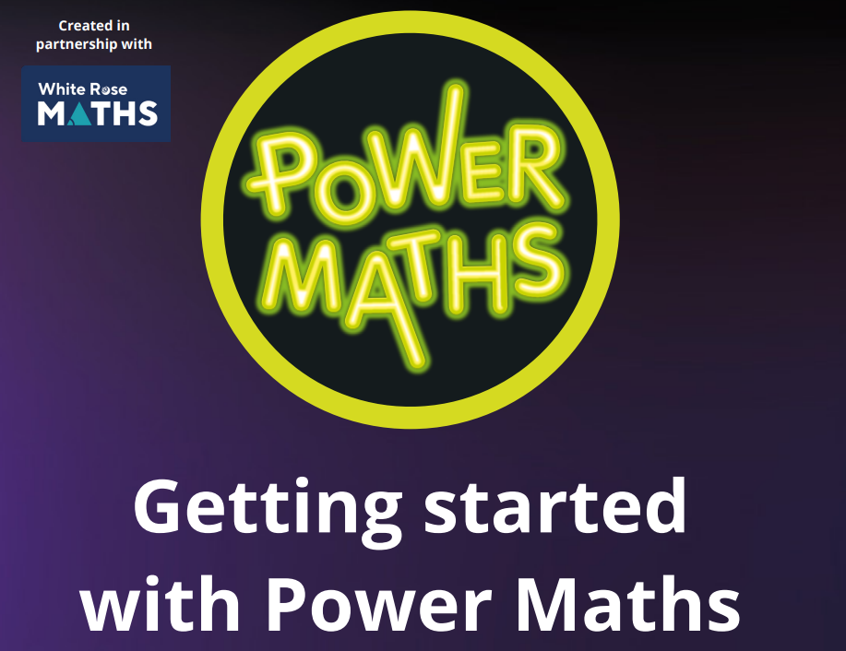

Power Maths is partnered with White Rose Maths to create a progression of small steps children need to take to master the content in each year group.
Each lesson is sequenced in steps for children to achieve the key idea for that day so all children can progress together. It is a whole class approach.
You have the flexibility to spend longer on a topic or lesson where you need to (see the Ready to Progress documents in Teams (Curriculum – Maths – Ready to Progress Documents).
Understand the Power Maths lessons

Slide 2
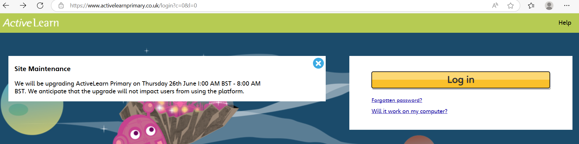
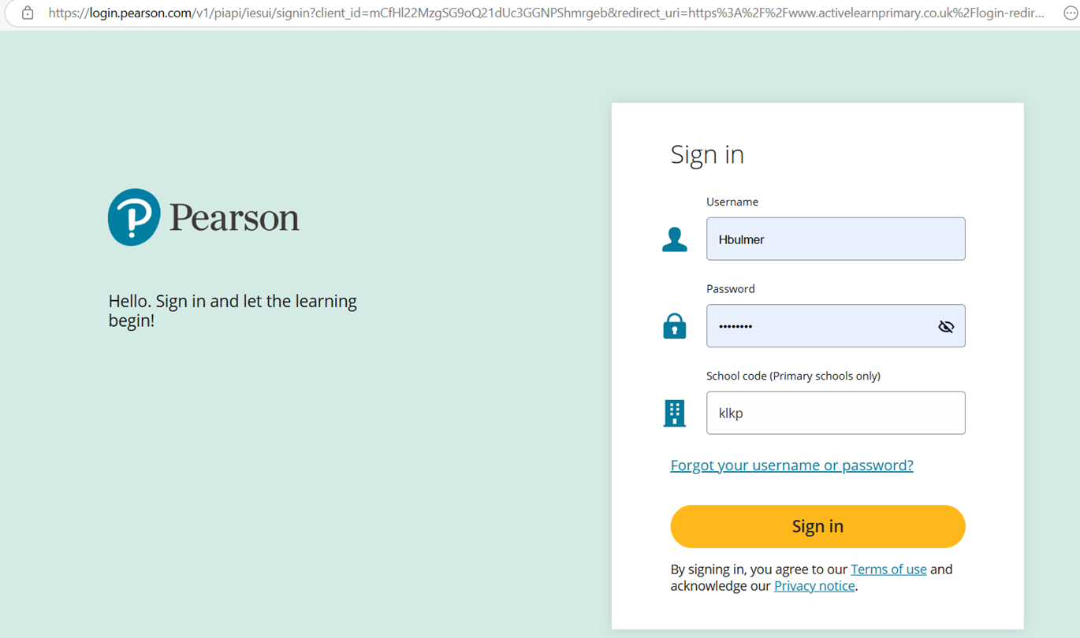
Hbulmer
nqwU4Jtn
klkp

Slide 3
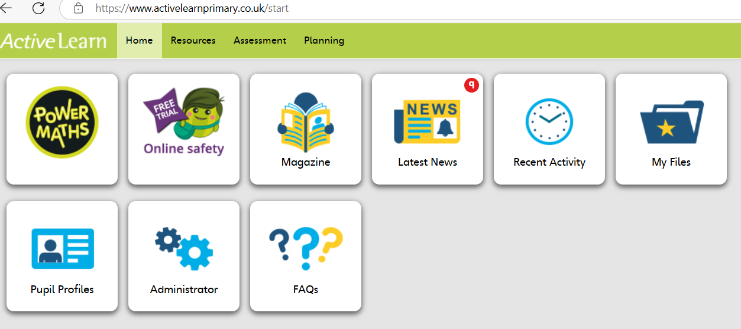

Slide 4
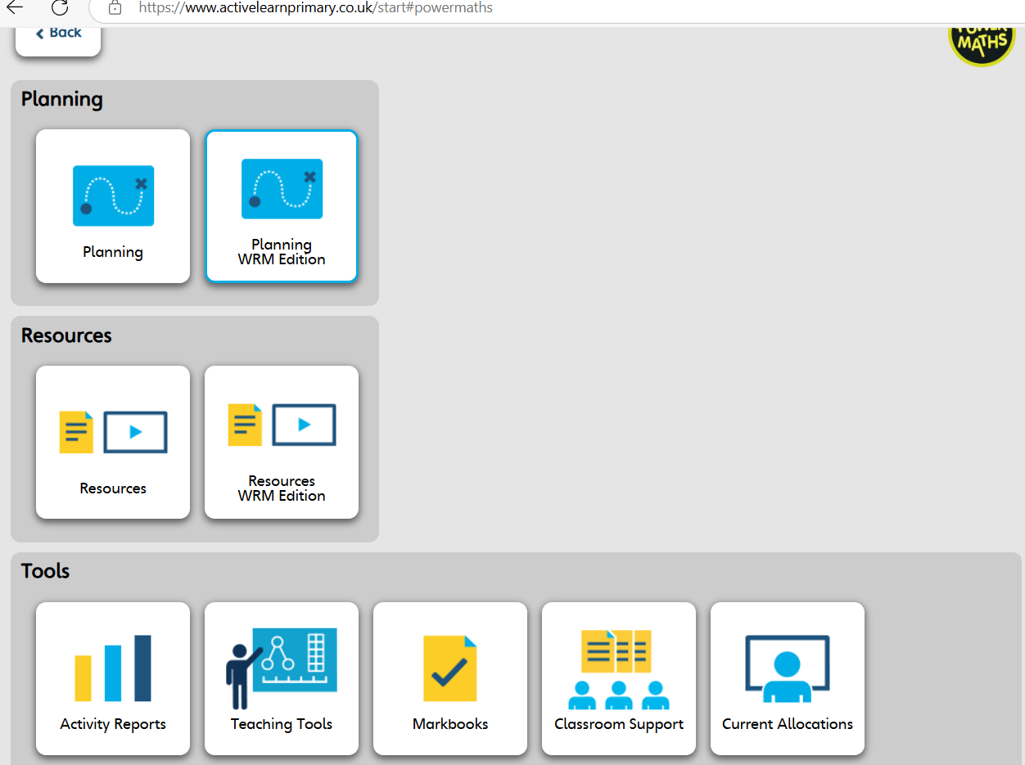
Planning WRM Edition

Slide 5
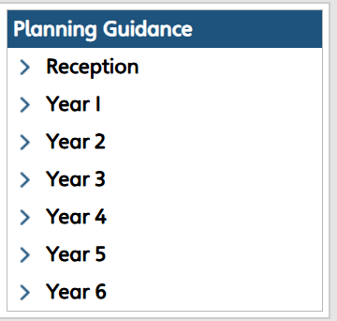
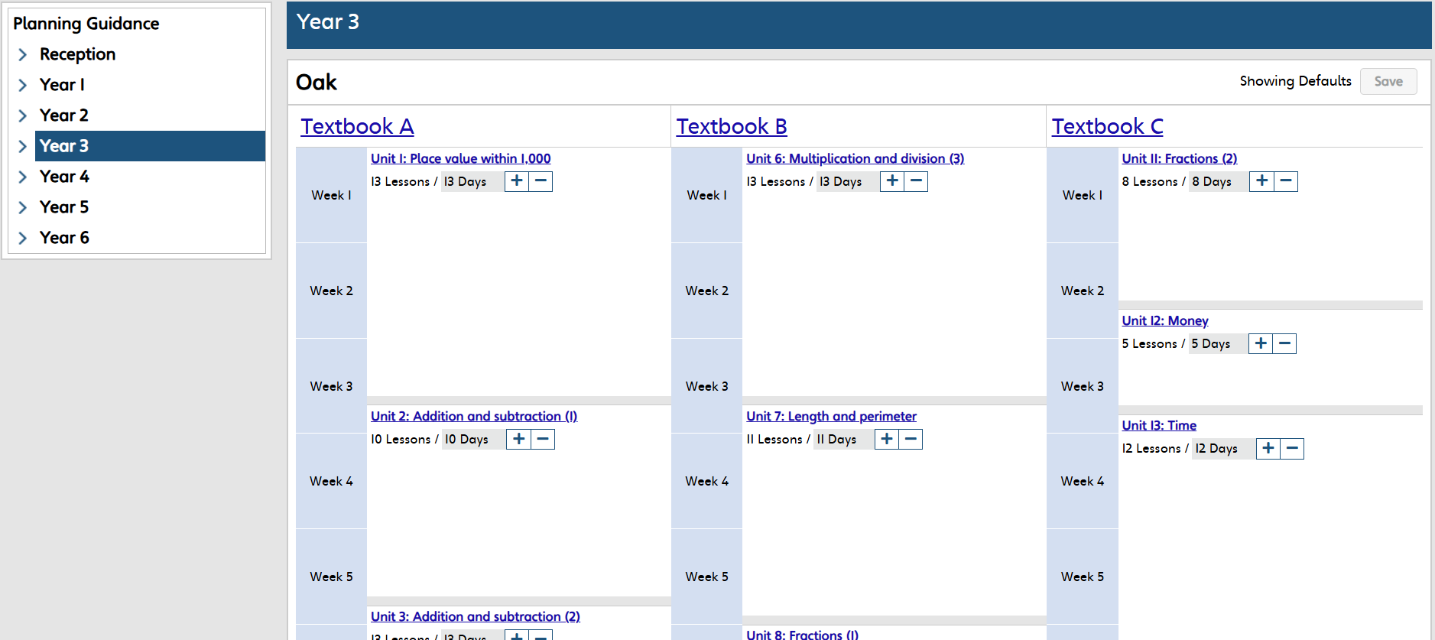
Planning WRM Edition

Slide 6
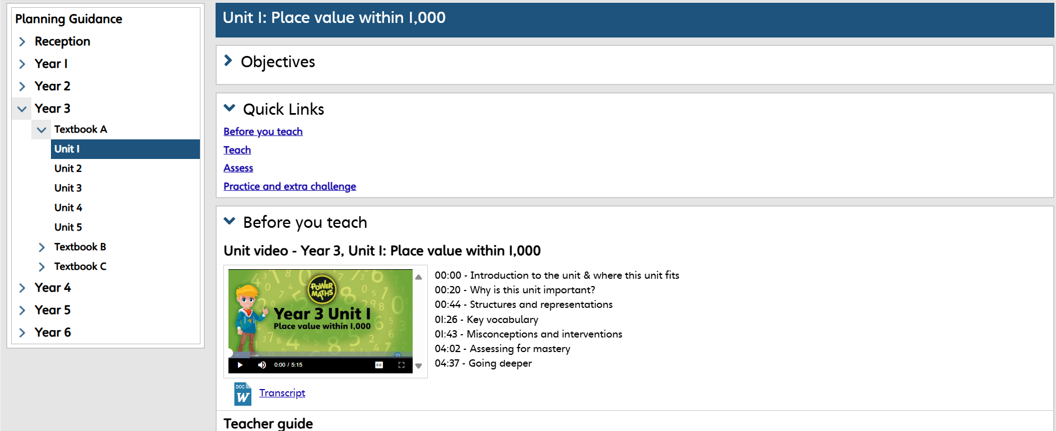

Slide 7
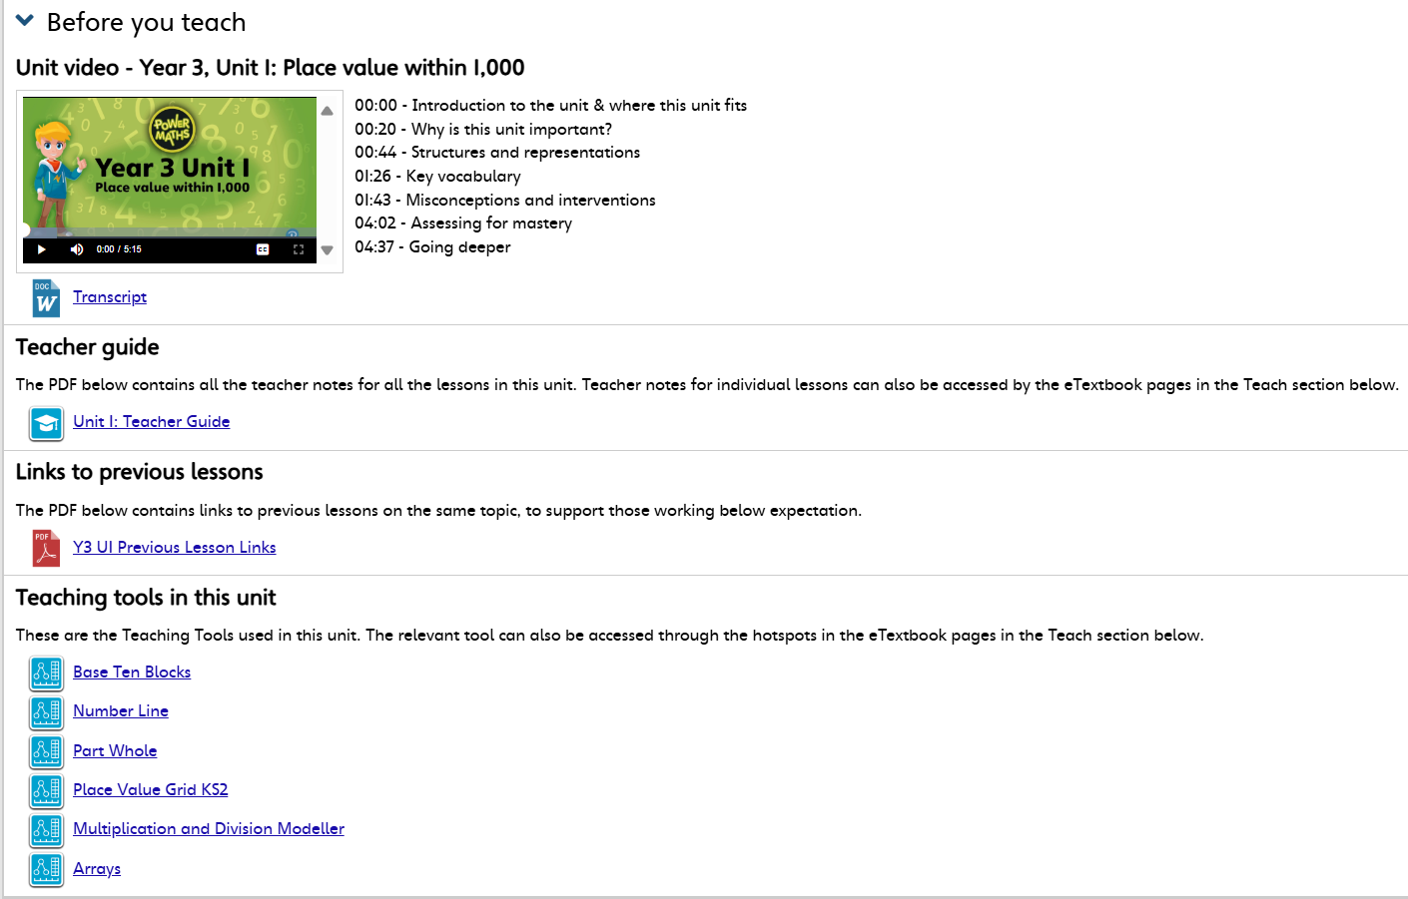

Slide 8
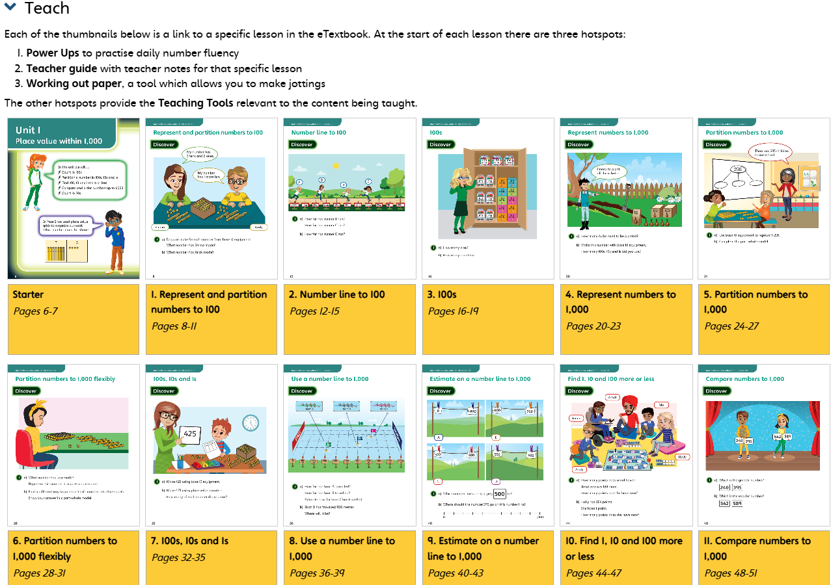

Slide 9
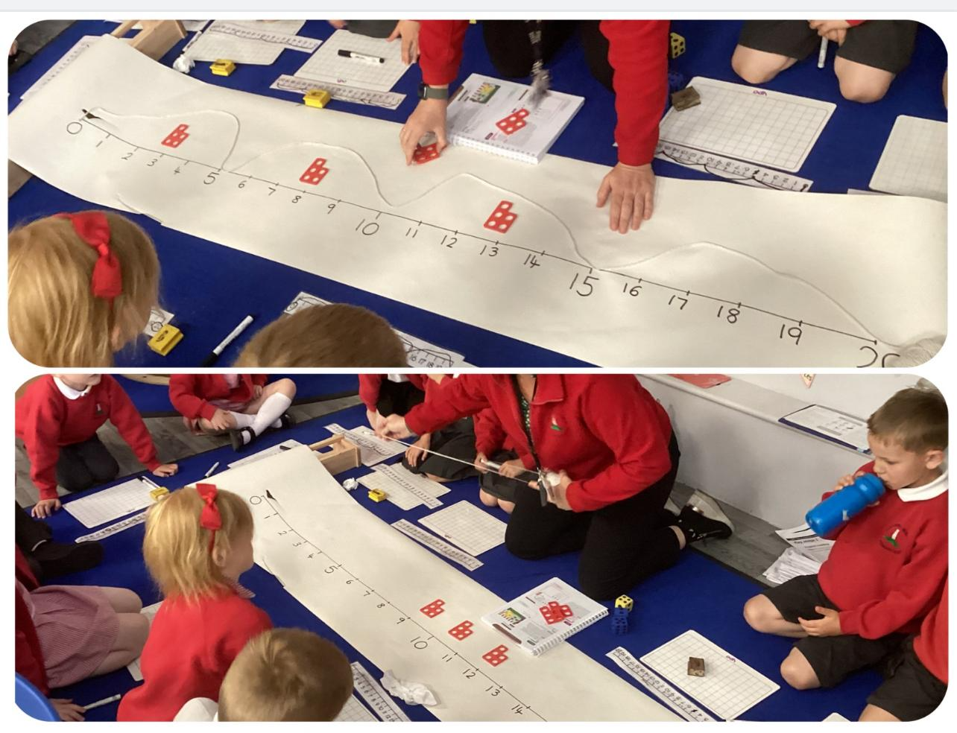


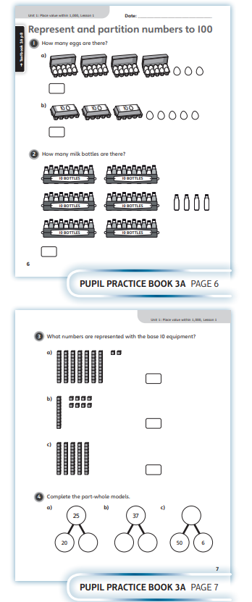

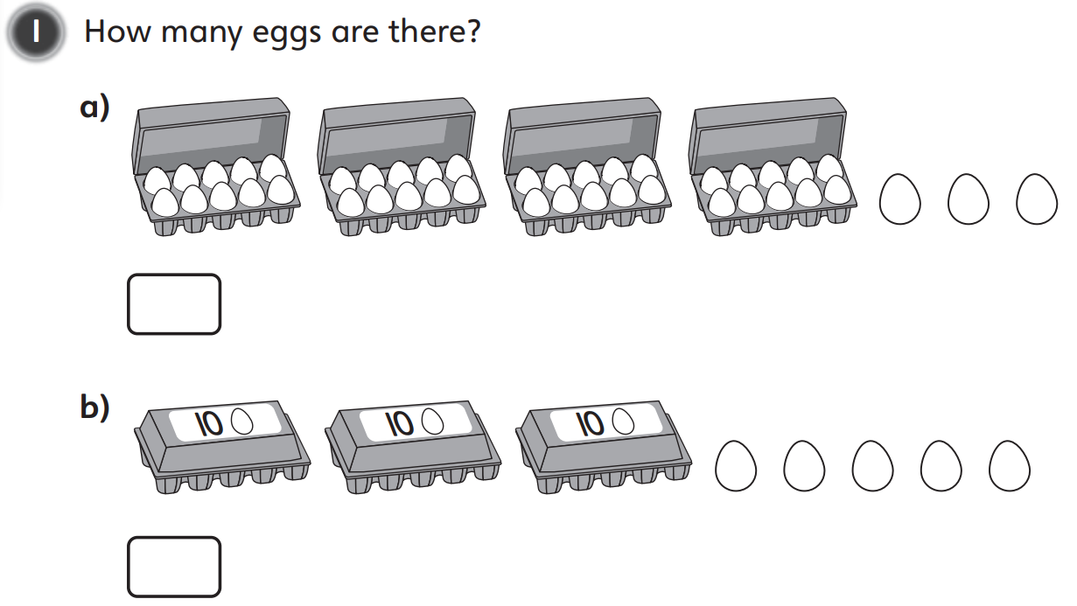
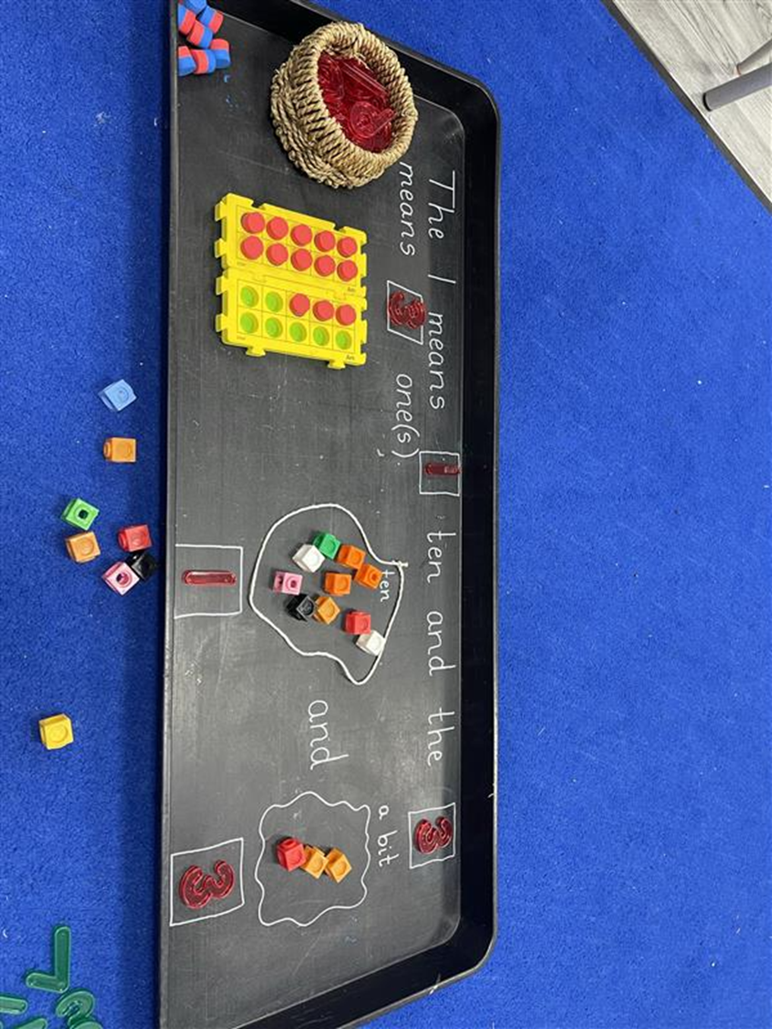
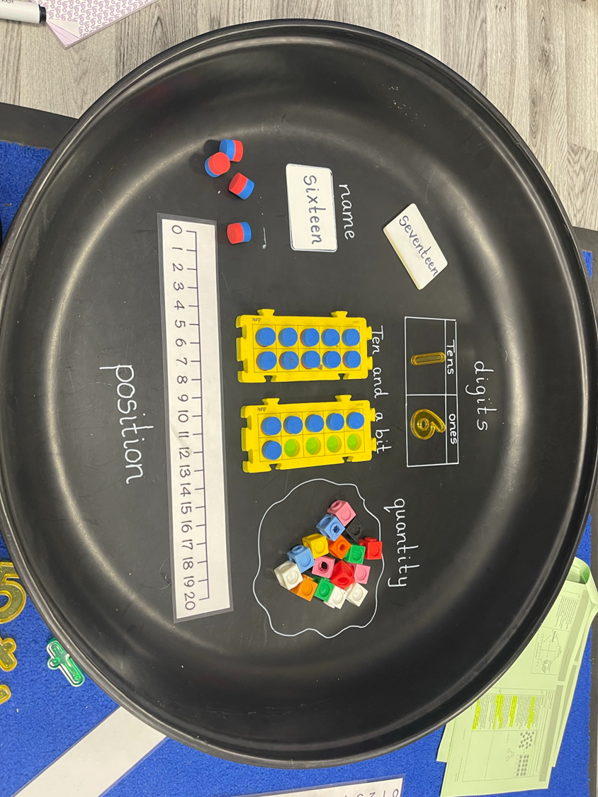
Lesson Structure:
Power Up
Discover (whole class)
Share (methods children can utilise that lesson – use the teacher tools!)
Think Together (practise and assess if children are ready for independence)
Practice Book work (3 pages, each on increasing in difficulty). Use Snipping Tool / Screenshot these pages from the teacher guide to create a PPT / IWB tool.

Slide 11
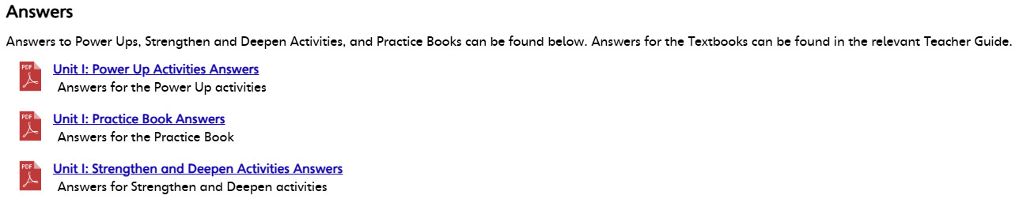
Reception | Live Marking
Year 1 and 2 | Live Marking
Year 3 and 4 | Mark as a class. Aim to mark at the end of each page.
Year 5 and 6 | Self mark using the Practice Book Answer booklets.

Slide 12
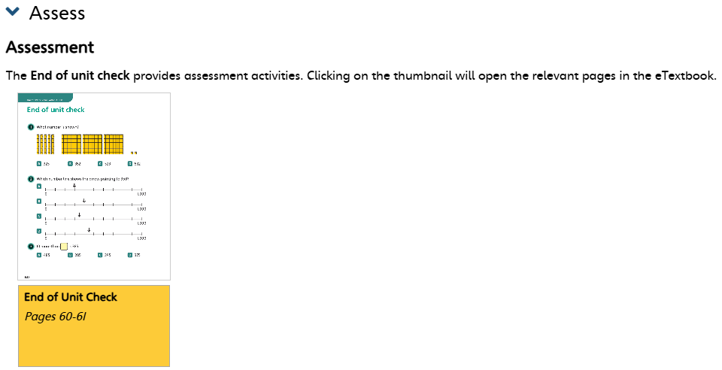
Assess at the end of each unit:
Answers for the End of Unit Check are found in the Teacher Guide!

