Slide 1
Faith squad- light Day
Visit to Holy Trinity and St Thomas’s School
(Faith through light November 2022)

Slide 2
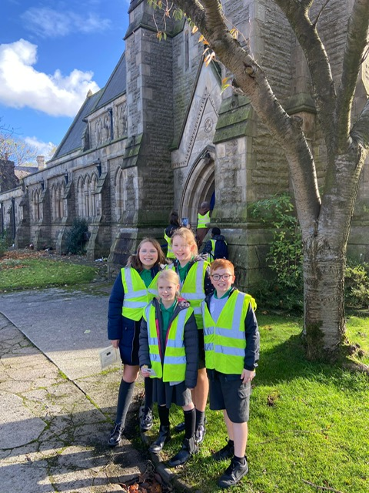
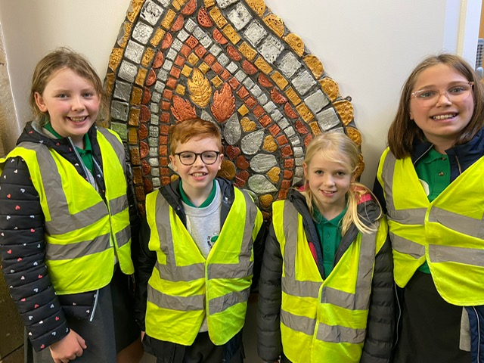

Slide 3
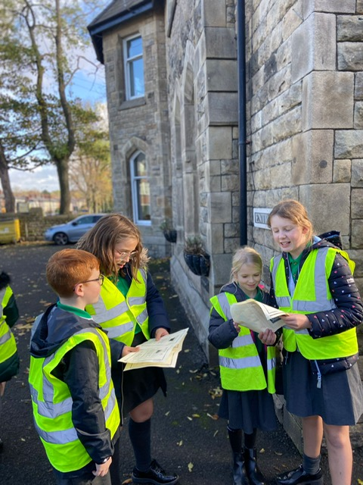
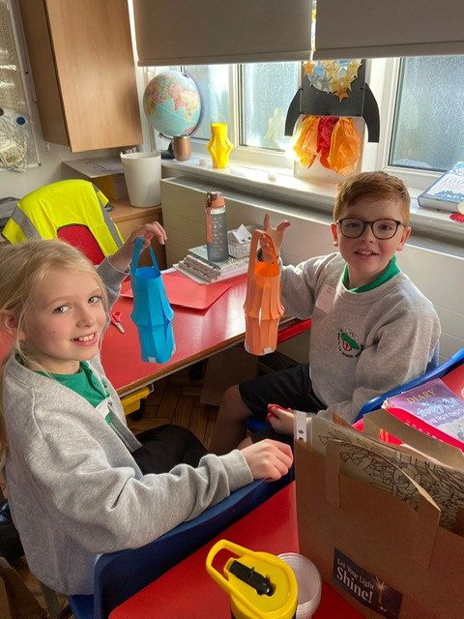

Slide 4
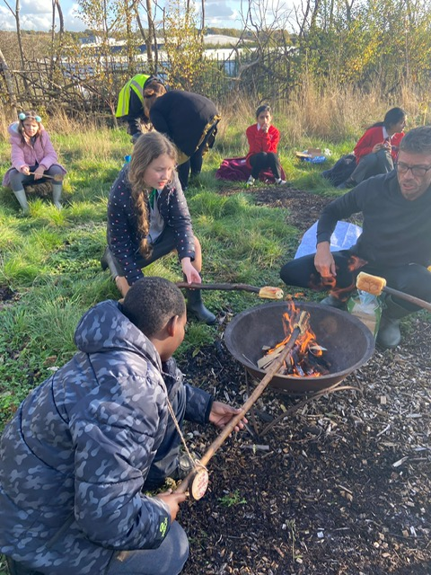
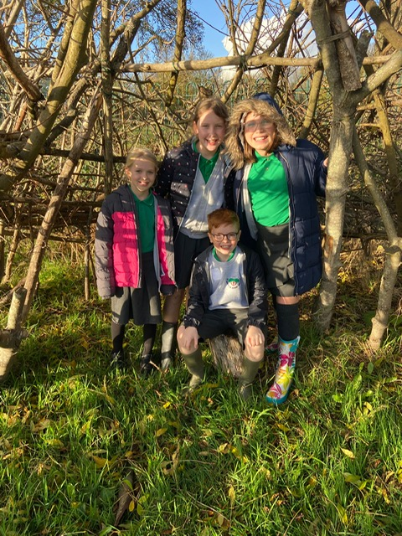

Slide 5
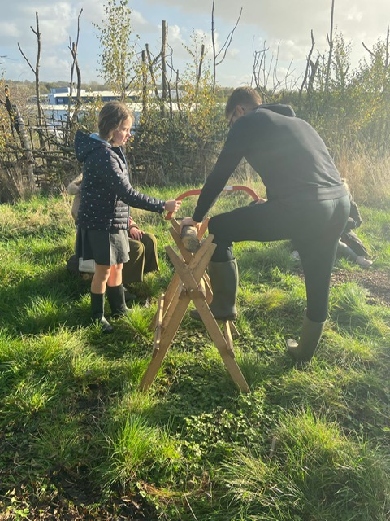
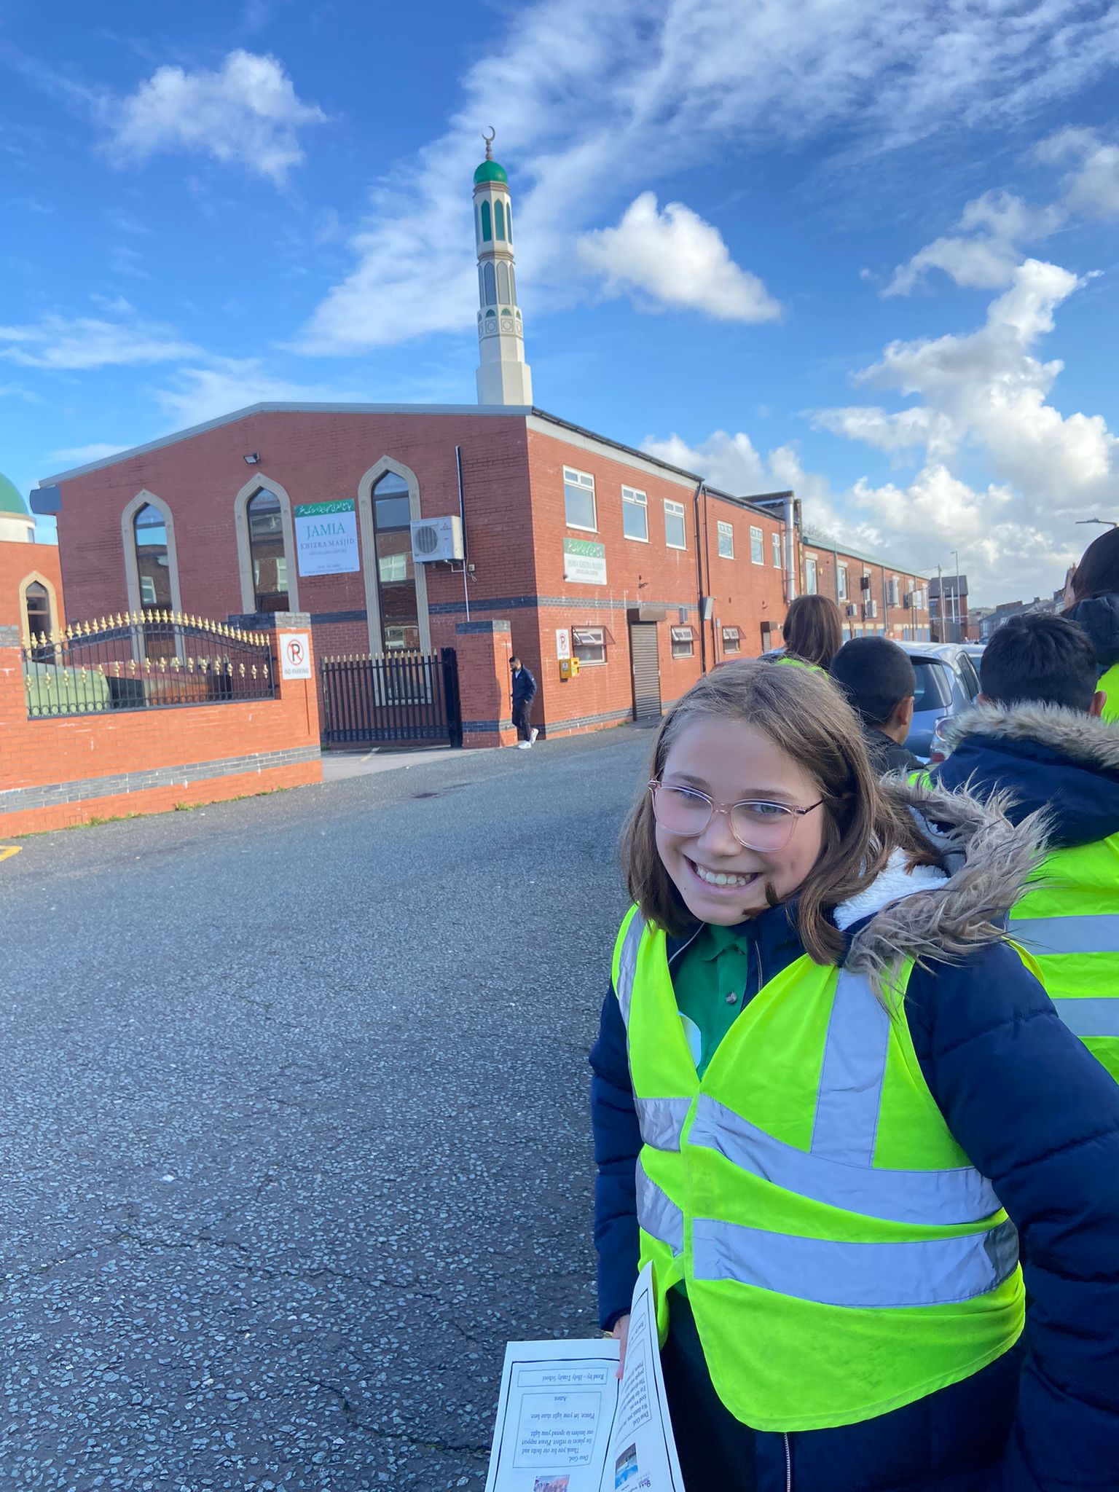

Slide 6
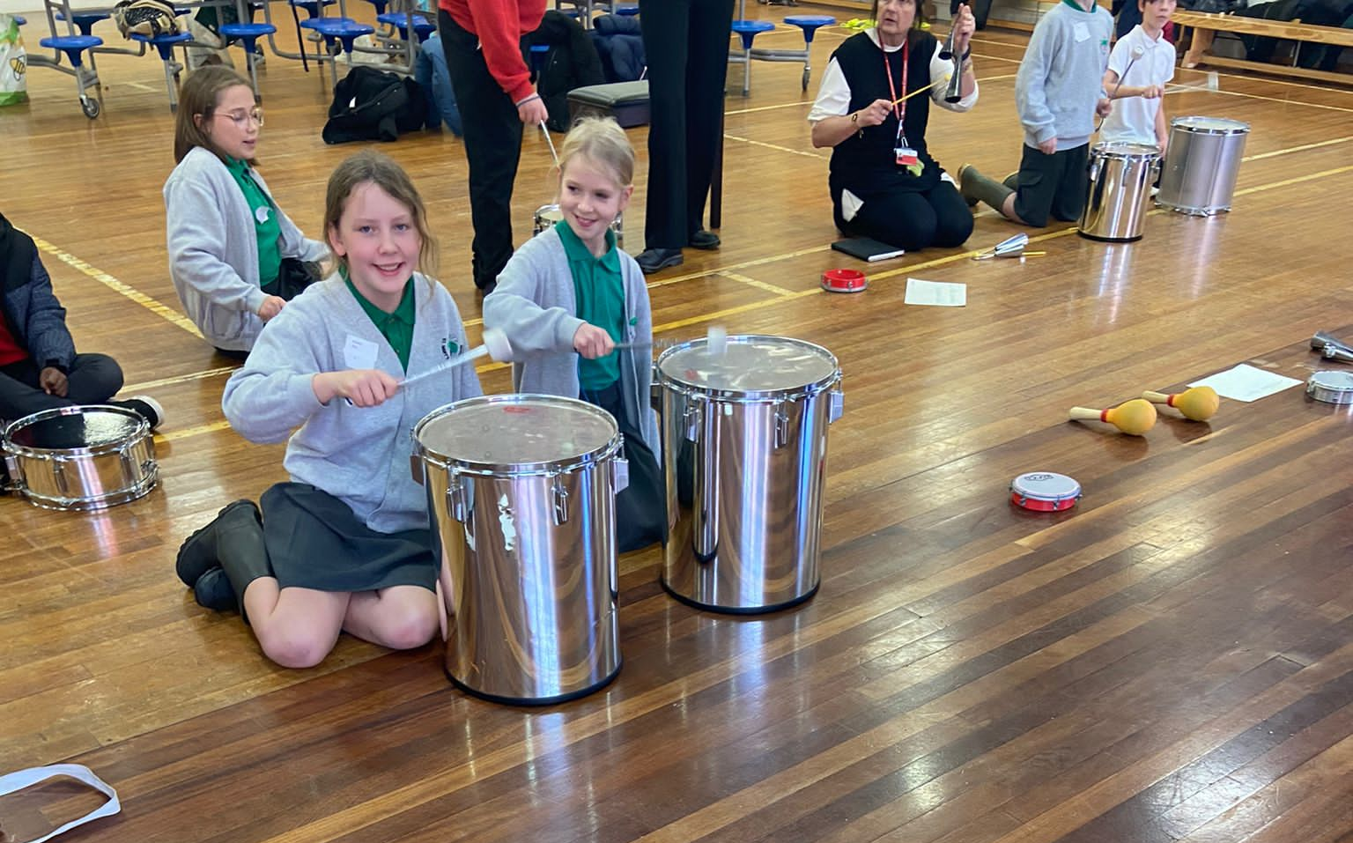
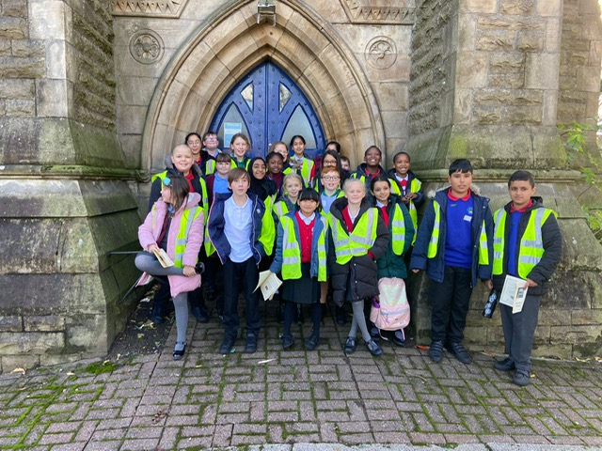

Slide 7
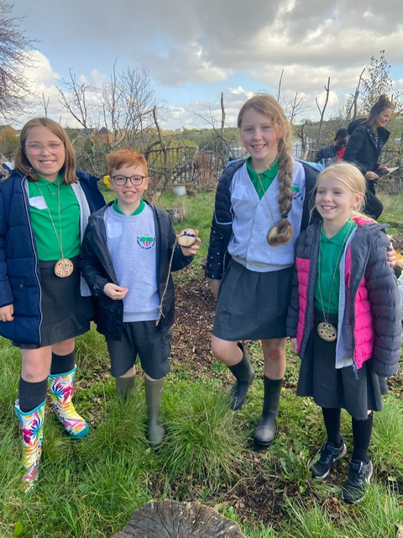
The children from ‘Faith Squad’ and Mrs Nuttall visited Holy Trinity school in Bury, where they completed activities based on other world Faiths.
The children, alongside lots of children from other schools, went on a ‘prayer walk’ to St Thomas’s.
The children visited ASDA, a residential care home, a Mosque, a farm and a Church, praying together outside each venue.
The Faith Squad had a fantastic time and gave feedback to the rest of the school during our Collective Worship.

